Slide 1

Correlation Between Major Crimes Indicators and Twitter Trends
BDA 106: Capstone Final Report
Bangar P., Brzozowski M., & Khudoyarova O.
Notes:
MAREK: (0:30)
The project is based on the proposal submission, where the idea is then developed into a data mining solution with final recommendations.
Cover: Informative title, team number and member names

Slide 2



Background & Research Project
Toronto Police Services (TPS) is dedicated to delivering police services, in partnership with their communities, to keep Toronto the best and safest place to be
With over 500 million public tweets per day, twitter can be a great resource in understanding people’s opinions on the events happening in the world.
This report explores the possibility of correlations between Major Crime Indicators (MCI) and public opinions expressed on Twitter.
This Photo by Unknown Author is licensed under CC BY
Notes:
Provide a brief background of organization/problem addressed. Business problem/opportunity (stakeholder, challenge/opportunity, humanity considerations)

Slide 3
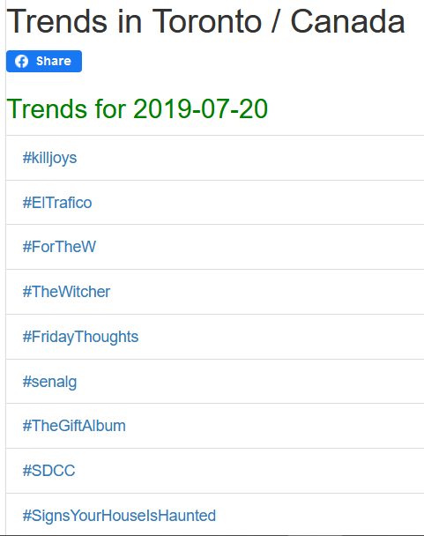
Data mining & description
Twitter Trends are based on an algorithm that determines which topics are popular at a particular time and place.
Trendogate pulls trends from Twitter
List of top 50 Trending Topics per day in Toronto
Unordered
Twitter Trending
Notes:
OLGA (1:30)

Slide 4
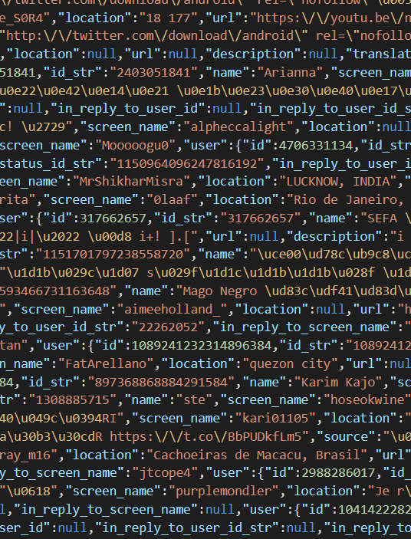
Data mining & description
Downloaded from Archive.org
Semi-structured Data
1% of all tweets
Nested JSON format
19.5GB for 1 day
Twitter Tweets
Notes:
OLGA (1:30)

Slide 5
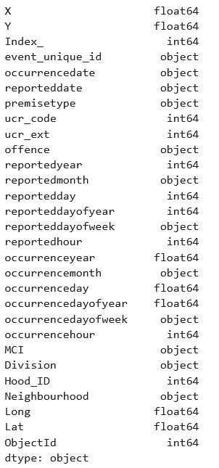
Data mining & description
Downloaded from the Toronto Police Services Website
Structured Data
29 columns
Major Crime details
Location
Offense
Date
206,435 rows
2014-2019
MCI
Notes:
OLGA (1:30)

Slide 6

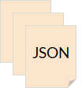

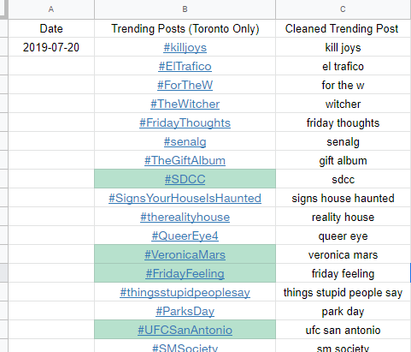
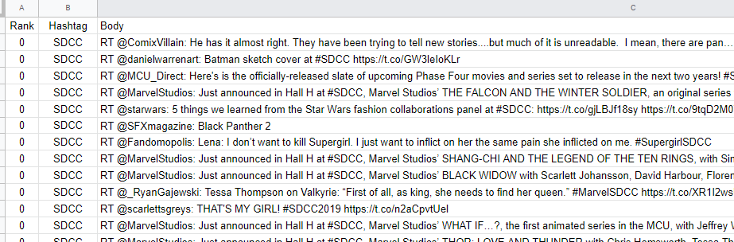
Data Cleansing
1 Day of Data
4.2 M
Trending Hashtag
Tweets
1.2 M
English only
Manually copied and pasted
Hashtags transformed
Top 10

Slide 7
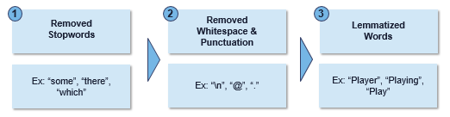

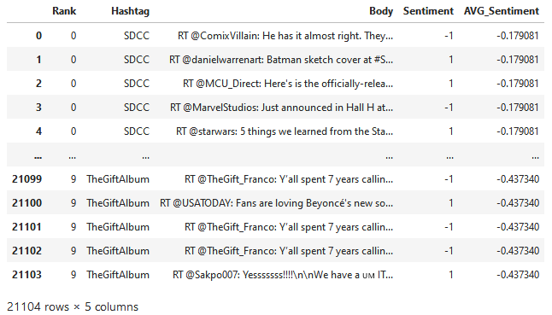
Text pre-processing
Text Blob
Sentiment Analysis
Labelled Tweets
+1 | +0.5 | 0 | -0.5 | -1

Slide 8


Feature Engineering resulted in nine new columns needed for analysis.
Final dataset for analysis:
2 months of data (June-July 2019)
MCI + sentiment analyzed Twitter Tweets
Important factor – Align them based on date
Major Crime Indicators
Location | Date | MCIs | Premise | ….
Feature Engineering

Slide 9


Data Analysis
Analysis were carried out using both Microsoft Azure Machine Learning Services and Python Methods.
Main Three Analysis Performed
Simple Two Column Analysis
Crime Sum Tier Classification
Crimes Stratified by Premise Type
Notes:
Marek (0:30)
Methods (methods, relevant outputs)

Slide 10
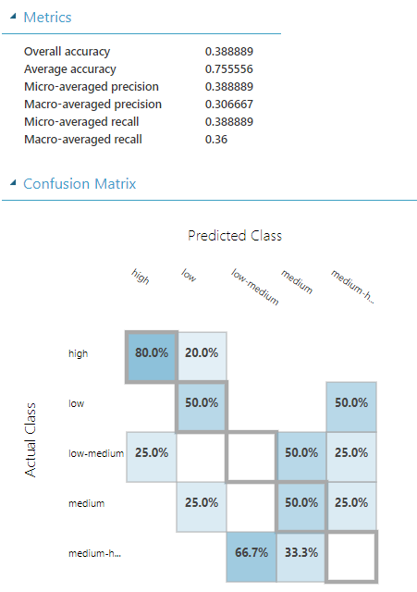
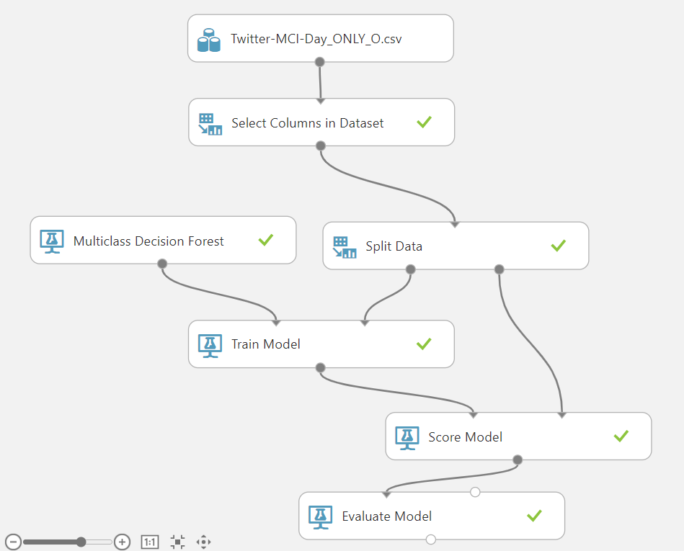
Simple Two Column Analysis
Two columns considered
Total of 61 rows, one row for each day.
Sentiment dictionary: labelled tweet
Feature: AverageHashtagSentiment
Target: Tier_SumofTotalCrimesPerDay
Divided into 5 equal bins depending on the sum of crimes per day
High, Medium-High, Medium, Low-Medium, Low
Multiclass Decision Forest Model
Accuracy, Prediction, Recall produced a value of 0.39.
Notes:
MAREK (2:00)
Methods (methods, relevant outputs)

Slide 11
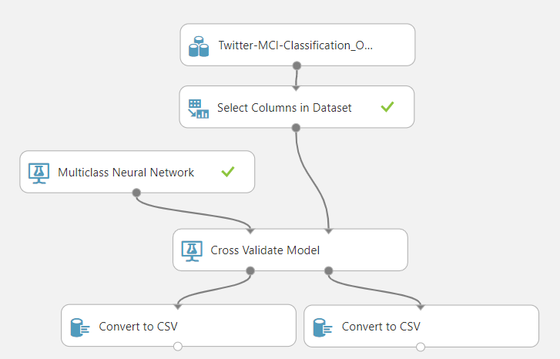
Crime Sum Tier Classification
Tier | Average Precision | Average Recall | Average LogLoss
High | 1 | 1 | 0.0013
Medium-High | 1 | 1 | 0.0029
Medium | 0.8982 | 0.9876 | 0.0843
Low-Medium | 0.9801 | 0.9263 | 0.1032
Low | 0.9921 | 0.9418 | 0.0829
Twelve columns from considered
Total of 7000 rows, one row for each crime.
Sentiment dictionary: labelled tweet
Features:
Top 10 Hashtag Sentiment
MCI labels
Target: Tier_SumofTotalCrimesPerDay
Multiclass Neural Network Model
Overfit
Lack of variance with trending data.
Notes:
MAREK (2:00)
Methods (methods, relevant outputs)

Slide 12
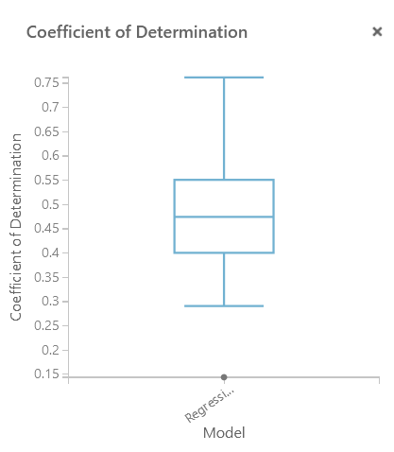
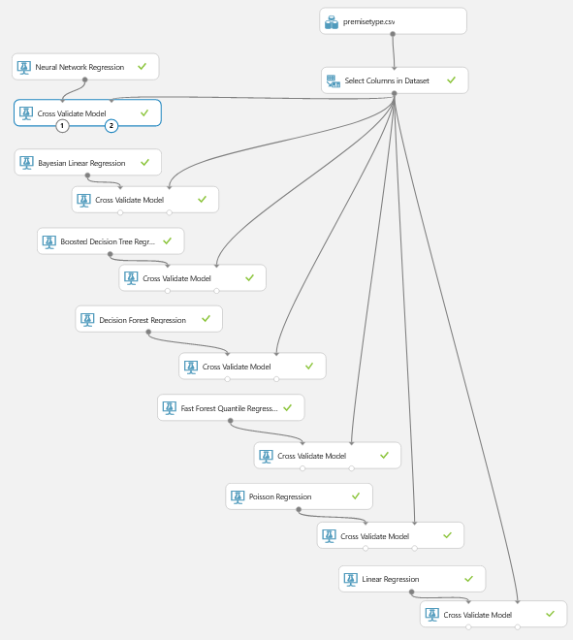
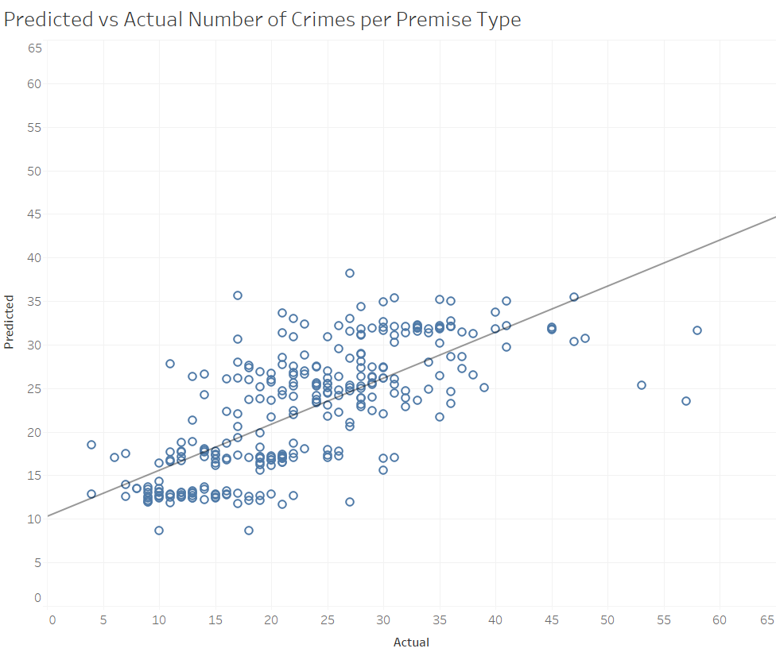
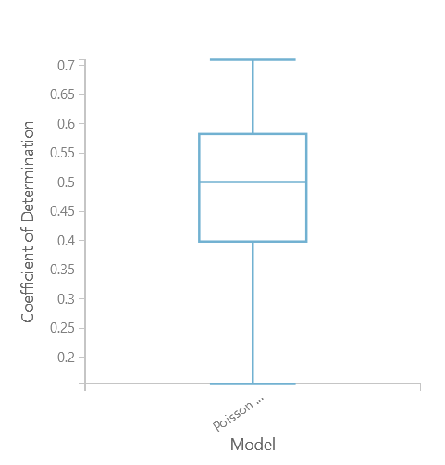
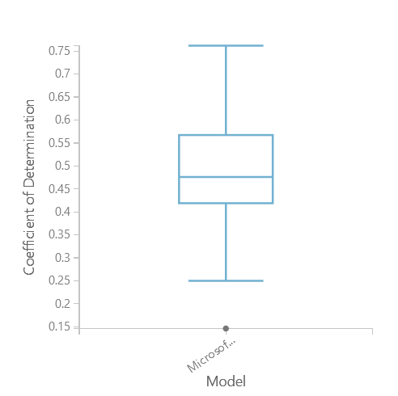
Regression Analysis of Crimes Stratified by Premise Type
Features: Top 10 Hashtag Sentiments, PremiseType
Target: Sum of crimes per premise type per day
Neural Network Regression
Average coefficients of determination after 10 folds: 0.5
Standard deviation of coefficients of determination: 0.14
Notes:
Olga (2:00) Methods (methods, relevant outputs)

Slide 13

Implications & Recommendations
We found a minor correlation between Twitter trends and major crime occurrence; however, more data is needed to confirm our findings.
Expand on the timeframe of data to analyze from two months to a year. Use trending hashtags by the hour if available.
Assign weight values based on hashtag ranks and sentiment values. Weights can also be assigned to retweets during the sentiment analysis stage to prevent them from overcrowding regular tweets.
A non-binary sentiment analysis representing emotion on a higher dimension and high-fidelity scale.
This Photo by Unknown Author is licensed under CC BY-SA-NC
Notes:
Olga (2:00)
Implications – so what can business/org do with findings/actions
Recommendations (what should the client be aware of? problems you encountered, suggestions for future data collection or analysis, etc.)

Slide 14
Questions?
Special thanks to Guido and Tom
Notes:
MAREK + OLGA + PARM
that you may have.
The project is based on the proposal submission, where the idea is then developed into a data mining solution with final recommendations.
Cover: Informative title, team number and member names

